Slide 1
Unit 202: Principles of electrical science
Generation of an EMF

Slide 2
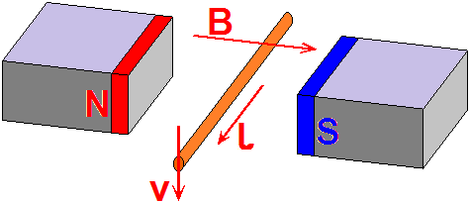
Generation of an EMF

Slide 3
Generation of an EMF
EXAMPLE 1. A conductor of 15cm in length is moved at 20 metre/second (m/s) perpendicularly through a magnetic field of flux density 2 teslas. Calculate the induced EMF.
e | = | Blv
 | = | 2 × 0.15 × 20
 | = | 6 volts

Slide 4
Generation of an EMF
EXAMPLE 2. A conductor of 0.5m in length is moved at 30 metre/second (m/s) perpendicularly through a magnetic field of flux density 3 teslas. Calculate the induced EMF.
e | = | Blv
 | = | 3 × 0.5 × 30
 | = | 45 volts

Slide 5
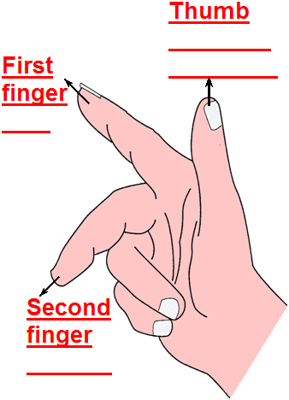
Generation of an EMF
Fleming’s right hand generator rule
Direction of motion
Field
Current

Slide 6
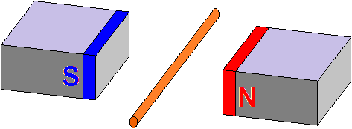
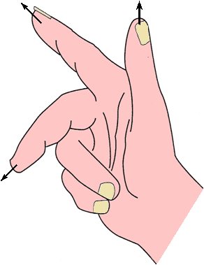

Generation of an EMF
Magnetic field goes this way from north to south
Conductor is moving upwards through the magnetic field
The current will flow towards us
Fleming’s right hand generator rule

Slide 7
Unit 202: Principles of electrical science
The End

